Slide 1
TRAFFIC MANAGEMENT
Introduction
A traffic monitoring system automatically and continuously monitors vehicles in moving traffic. Sensors that are installed in or near the road are used to record, aggregate, evaluate and visualize a wide variety of parameters from vehicles, infrastructure and the environment.

Slide 2
What is a Traffic Managment System?
Definition:
A system, which advises the command-control and signaling system and receives for this purpose information about the current traffic situation and future demand and disturbances from other systems.
Key Components:
Radio frequency identification (RFID) tags.
Automatic identification and data collection (AIDC) tags.
Temperature sensors.
Air quality sensors.

Slide 3
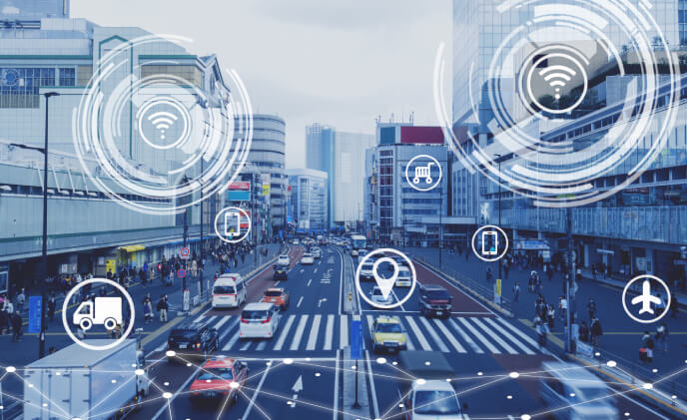
Importance of Traffic Management System
Traffic management can improve the flow of traffic on the roads, reducing emissions per vehicle kilometer traveled and enhancing urban mobility.
Temporary traffic management is also necessary to manage the increased flow of traffic during a special event, such as a festival or concert.

Slide 4
Components of Traffic Management Systems
Sensors:
Radio frequency identification (RFID) tags. Automatic identification and data collection (AIDC) tags.
Data Analytics: Analyze data to identify patterns and anomalies.
Communication Networks: Transmit data to central control systems.
Control Systems: Implement automated actions for traffic management.

Slide 5
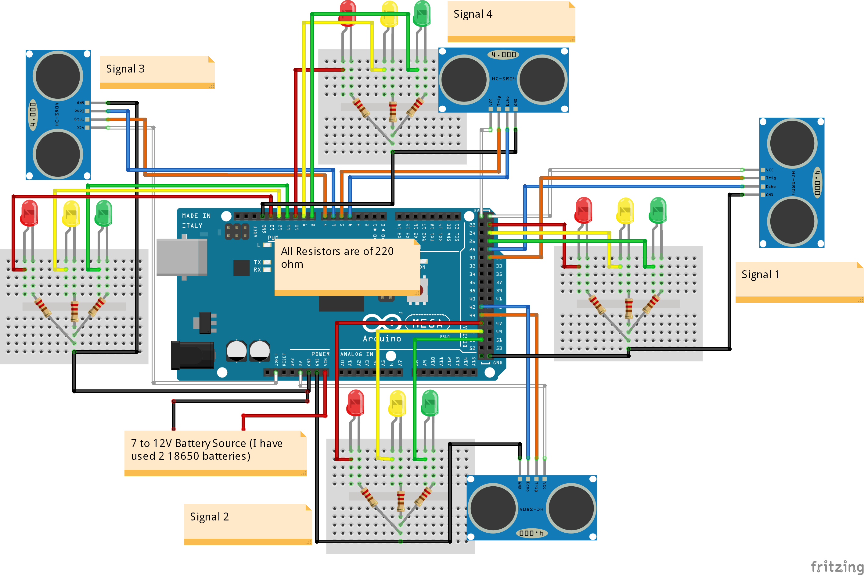
Traffic Management System circuit diagram

Slide 6
Benefits of Smart Water Systems
Predictive Insights. One of the top benefits of smart traffic management systems is the predictive insights that they offer.
Enhanced Safety.
Cost Reduction.
Improved Emergency Response.
Minimized Emissions.

Slide 7
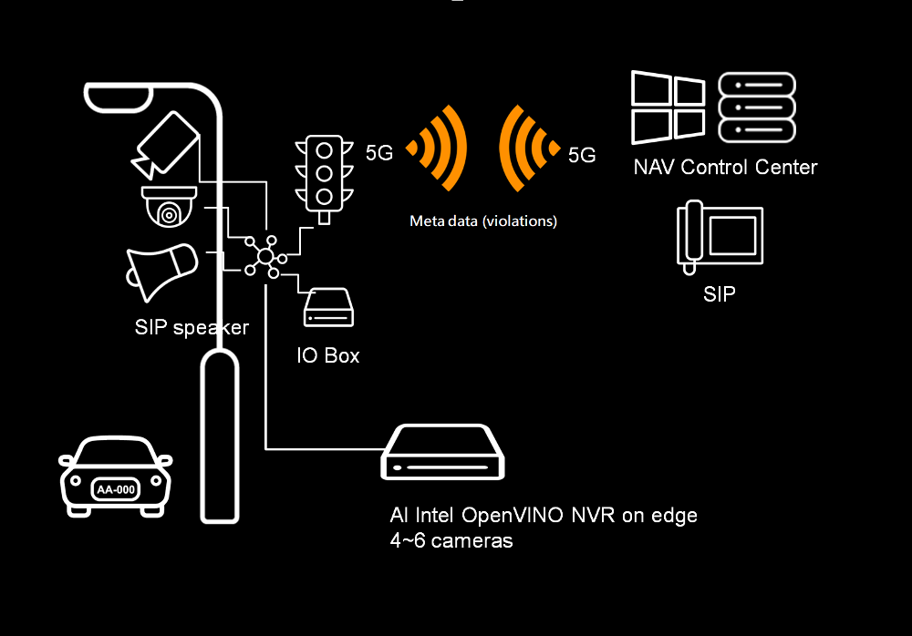
Traffic Management System model

Slide 8
Conclusion
Prevent congestion and ensure that vehicles are parked in designated areas. Finally, traffic signs provide information about maintaining the desired speed limit while crossing any institute to prevent accidents.
The most important goal is creating and maintaining efficient, safe roadways. Traffic engineers work hard to minimize congestion and safety risks on the road, making roadways safe for drivers, cyclists, and pedestrians.

